Slide 1
Chapter - 3
Project Time Management

Slide 2
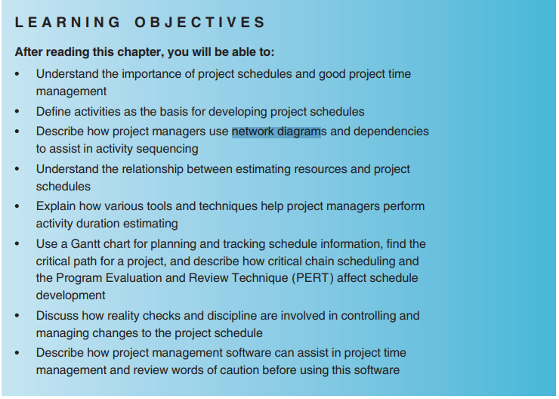

Slide 3
Project Scheduling
Project Scheduling in a project refers to roadmap of all activities to be done with specified order and within time slot allotted to each activity.
Project managers tend to define various tasks, and project milestones and arrange them keeping various factors in mind.
They look for tasks lie in critical path in the schedule, which are necessary to complete in specific manner (because of task interdependency) and strictly within the time allocated.
Arrangement of tasks which lies out of critical path are less likely to impact over all schedule of the project.
Notes:
project charter — a document that formally recognizes the existence of a project and provides direction on the project's objectives and management

Slide 4
Cont’d
For scheduling a project, it is necessary to -
Break down the project tasks into smaller, manageable form
Find out various tasks and correlate them
Estimate time frame required for each task
Divide time into work-units
Assign adequate number of work-units for each task
Calculate total time required for the project from start to finish

Slide 5
Importance of Project Schedules
Managers often cite delivering projects on time as one of their biggest challenges
Average time overrun from 1995 CHAOS report was 222%; improved to 163% in 2001 study
Time has the least amount of flexibility; it passes no matter what
Schedule issues are the main reason for conflicts on projects, especially during the second half of projects

Slide 6
Project Time Management Processes
Recall the triple constraint of project management balancing scope, time, and cost goals and note the order of these items.
Ideally, the project team and key stakeholders first define the project scope, then the time or schedule for the project, and then the project cost.
There are six main processes involved in project time management:

Slide 7
Cont’d
Defining activities involves identifying the specific activities that the project team members and stakeholders must perform to produce the project deliverables. An activity or task is an element of work normally found on the work breakdown structure (WBS) that has an expected duration, a cost, and resource requirements. The main outputs of this process are an activity list,
activity attributes, and milestone list.
Sequencing activities involves identifying and documenting the relationships between project activities. The main outputs of this process include project schedule network diagrams and project document updates.

Slide 8
Cont’d
3. Estimating activity resources involves estimating how many resources
people, equipment, and materials a project team should use to perform
project activities. The main outputs of this process are activity resource
requirements, a resource breakdown structure, and project document
updates.
4. Estimating activity durations involves estimating the number of work periods that are needed to complete individual activities. Outputs include activity duration estimates and project document updates.

Slide 9
Cont’d
5. Developing the schedule involves analyzing activity sequences, activity
resource estimates, and activity duration estimates to create the project schedule. Outputs include a project schedule, a schedule baseline, schedule data, and project document updates.
6. Controlling the schedule involves controlling and managing changes to the
project schedule. Outputs include work performance measurements, organizational process assets updates, change requests, project management plan updates, and project document updates.

Slide 10
Defining Activities
An activity or task is an element of work normally found on the work breakdown structure (WBS) that has an expected duration, a cost, and resource requirements
Activity definition involves developing a more detailed WBS and supporting explanations to understand all the work to be done so you can develop realistic cost and duration estimates
Project schedules grow out of the basic documents that initiate a project:
Project charter includes the start and end dates and budget information
Scope statement and WBS help define what will be done

Slide 11
Activity Sequencing
Involves reviewing activities and determining dependencies
Mandatory dependencies: inherent in the nature of the work being performed on a project, sometimes referred to as hard logic
  Example: write code, then test code
Discretionary dependencies: defined by the project team., sometimes referred to as soft logic and should be used with care since they may limit later scheduling options
    Example: good practice to get sign-offs before performing the work
External dependencies: involve relationships between project and non-project activities
  Example: tasks dependent of delivery of hardware from an outside vendor
  You must determine dependencies in order to use critical path analysis

Slide 12
Project Network Diagrams
Project network diagrams are the preferred technique for showing activity sequencing
A project network diagram is a schematic display of the logical relationships among, or sequencing of, project activities

Slide 13
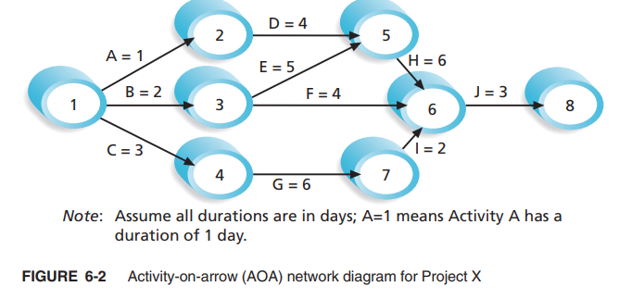
Cont’d

Slide 14
Cont’d
The format of this network diagram uses the activity-on-arrow (AOA) approach or the arrow diagramming method (ADM) a network diagramming technique in which activities are represented by arrows and connected at points called nodes to illustrate the sequence of activities.
Can only show finish-to-start dependencies.
A node is simply the starting and ending point of an activity.
The first node signifies the start of a project, and the last node represents the end of a project.

Slide 15
Process for Creating AOA Diagrams
Find all of the activities that start at node 1. Draw their finish nodes and draw arrows between node 1 and those finish nodes. Put the activity letter or name and duration estimate on the associated arrow.
Continuing drawing the network diagram, working from left to right. Look for bursts and merges. A burst occurs when a single node is followed by two or more activities. A merge occurs when two or more nodes precede a single node.
Continue drawing the project network diagram until all activities that have dependencies are included in the diagram.
As a rule of thumb, all arrowheads should face toward the right, and no arrows should cross in an AOA network diagram.

Slide 16
Precedence Diagramming Method (PDM)
Activities are represented by boxes.
Arrows show relationships between activities.
More popular than ADM method and used by project management software.
Better at showing different types of dependencies.

Slide 17
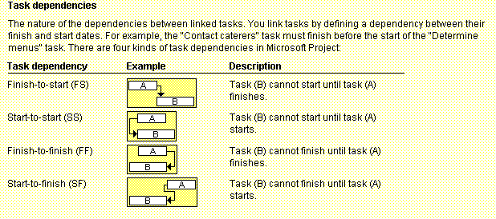
Figure 6-3 illustrates the types of dependencies that can occur among project activities. After you determine the reason for a dependency between activities (mandatory,

Slide 18
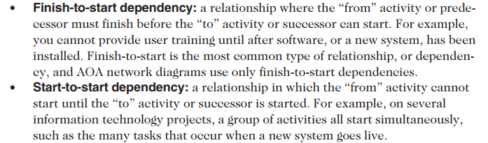
Cont’d
The four types of dependencies or relationships between activities include:

Slide 19
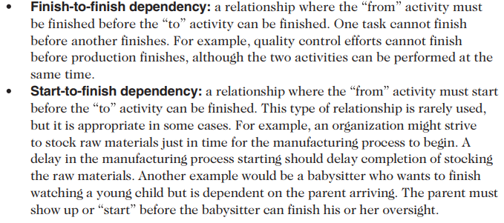
Cont’d

Slide 20
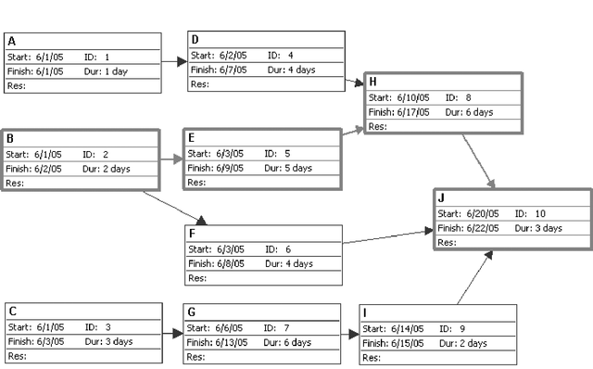
Figure 6-4. Sample PDM Network Diagram

Slide 21
Activity Resource Estimating
Before estimating activity durations, you must have a good idea of the quantity and type of resources that will be assigned to each activity.
  resources are people, equipment, and materials
Consider important issues in estimating resources
  How difficult will it be to do specific activities on this project?
  Anything unique about the project?
  What is the organization’s history in doing similar activities?
  Are the required resources available? Level of experience for each person? Can the organization acquire more resources?
A resource breakdown structure is a hierarchical structure that identifies the project’s resources by category and type.

Slide 22
Estimating Activity Durations
Duration includes the actual amount of time worked on an activity plus the elapsed time.
Effort is the number of workdays or work hours required to complete a task.
Effort does not normally equal duration.
People doing the work should help create estimates, and an expert should review them.

Slide 23
Cont’d
Instead of providing activity estimates as a discrete number, such as four weeks, it’s often helpful to create a three-point estimate
  an estimate that includes an optimistic, most likely, and pessimistic estimate, such as three weeks for the optimistic, four weeks for the most likely, and five weeks for the pessimistic estimate

Slide 24
Cont’d
The optimistic estimate is based on a best-case scenario, while
the pessimistic estimate is based on a worst-case scenario.
The most likely estimate, as it sounds, is an estimate based on a most likely or expected scenario.
Three-point estimates are needed for PERT and Monte Carlo simulations

Slide 25
Developing the Schedule
Uses results of the other time management processes to determine the start and end date of the project
Ultimate goal is to create a realistic project schedule that provides a basis for monitoring project progress for the time dimension of the project
Important tools and techniques:
  Gantt charts
  Critical path analysis
  Critical chain scheduling
  PERT analysis

Slide 26
Gantt charts
Gantt charts provide a standard format for displaying project schedule information by listing project activities and their corresponding start and finish dates in a calendar format
Symbols include:
  A black diamond: a milestones
  Thick black bars: summary tasks
  Lighter horizontal bars: durations of tasks
  Arrows: dependencies between tasks

Slide 27
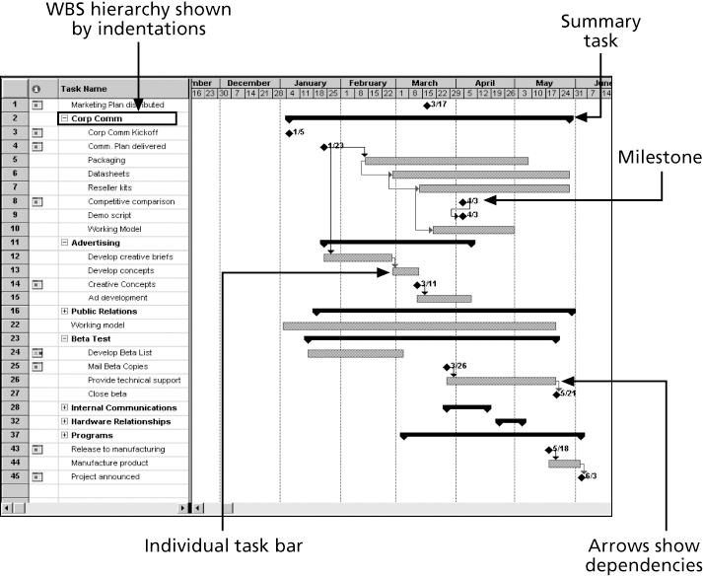
Figure 6-6. Gantt Chart for Software Launch Project

Slide 28
Adding Milestones to Gantt Charts
Many people like to focus on meeting milestones, especially for large projects
Milestones emphasize important events or accomplishments on projects
Normally create milestone by entering tasks with a zero duration, or you can mark any task as a milestone

Slide 29
Cont’d
To make milestones meaningful, some people use the SMART criteria to help define them.
  The SMART criteria are guidelines suggesting that milestones should be:
  Specific
  Measurable
  Assignable
  Realistic
  Time-framed

Slide 30
Cont’d
For example, distributing a marketing plan is specific, measurable, and assignable if everyone knows what should be in the marketing plan, how it should be distributed, how many copies should be distributed and to whom, and who is responsible for the actual delivery.
Distributing the marketing plan is realistic and able to be time-framed if it is an achievable event and scheduled at an appropriate time.

Slide 31
Best Practice
Schedule risk is inherent in the development of complex systems. Luc Richard, the founder of www.projectmangler.com, suggests that project managers can reduce schedule risk through project milestones, a best practice that involves identifying and tracking significant points or achievements in the project. The five key points of using project milestones include the following:
  1. Define milestones early in the project and include them in the Gantt chart to provide a visual guide
  2. Keep milestones small and frequent
  3. The set of milestones must be all-encompassing
  4. Each milestone must be binary, meaning it is either complete or incomplete.
  5. Carefully monitor the critical path

Slide 32
Figure 6-7 shows a Tracking Gantt chart
Tracking Gantt chart a Gantt chart that compares planned and actual project schedule information.
The planned schedule dates for activities are called the baseline dates, and the entire approved planned schedule is called the schedule baseline.
The Tracking Gantt chart includes columns (hidden in Figure 6-7) labeled Start and Finish to represent actual start and finish dates for each task, as well as columns labeled Baseline Start and Baseline Finish to represent planned start and finish dates for each task. In this example, the project is completed, but several tasks missed their planned start and finish dates

Slide 33
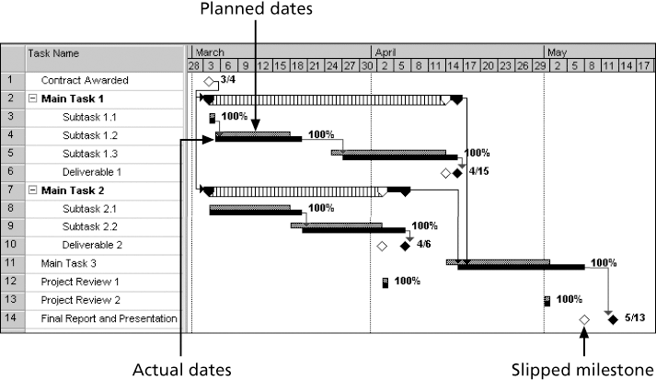

Figure 6-7 shows a Tracking Gantt chart

Slide 34
Figure 6-7 shows a Tracking Gantt chart
Notice that the Gantt chart in Figure 6-7 often shows two horizontal bars for tasks. The top horizontal bar represents the planned or baseline duration for each task. The bar below it represents the actual duration. Subtasks 1.2 and 1.3 illustrate this type of display.
A white diamond on the Tracking Gantt chart represents a slipped milestone. A slipped milestone means the milestone activity was actually completed later than originally planned. For example, the last task provides an example of a slipped milestone since the final report and presentation were completed later than planned. Percentages to the right of the horizontal bars display the percentage of work completed for each task. For example, 100 percent means the task is finished, 50 percent means the task is still in progress and is 50 percent completed.

Slide 35
Critical Path Method (CPM)
CPM is a network diagramming technique used to predict total project duration
A critical path for a project is the series of activities that determines the earliest time by which the project can be completed
The critical path is the longest path through the network diagram and has the least amount of slack or float
Slack or float is the amount of time an activity may be delayed without delaying a succeeding activity or the project finish date

Slide 36
Calculating the Critical Path
First develop a good network diagram
Add the duration estimates for all activities on each path through the network diagram
The longest path is the critical path
If one or more of the activities on the critical path takes longer than planned, the whole project schedule will slip unless the project manager takes corrective action

Slide 37
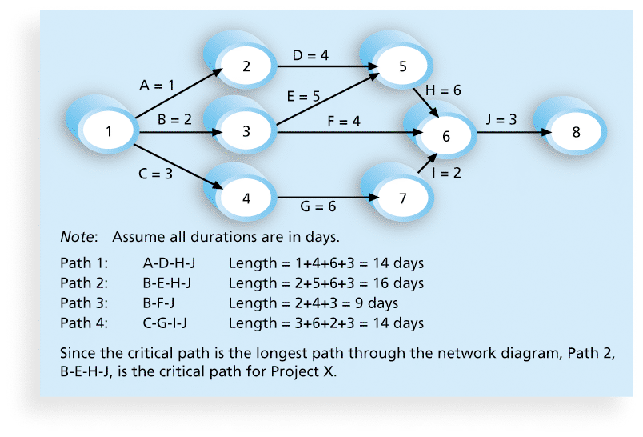
Figure 6-8. Determining the Critical Path for Project X

Slide 38
Using Critical Path Analysis to Make Schedule Trade-offs
Free slack or free float is the amount of time an activity can be delayed without delaying the early start of any immediately following activities
Total slack or total float is the amount of time an activity may be delayed from its early start without delaying the planned project finish date
A forward pass through the network diagram determines the early start and finish dates
A backward pass determines the late start and finish dates

Slide 39
Scheduling with activity time
Activity Immediate Completion
predecessors Time (week)
A - 5
B - 6
C A 4
D A 3
E A 1
F E 4
G D,F 14
H B,C 12
I G,H 2
Total …… 51
This information indicates that the total time required to complete activities is 51 weeks. However, we can see from the network that several of the activities can be conducted simultaneously (A and B, for example).

Slide 40
Earliest start & earliest finish time
We are interested in the longest path through the network, i.e., the critical path.
Starting at the network’s origin (node 1) and using a starting time of 0, we compute an earliest start (ES) and earliest finish (EF) time for each activity in the network.
The expression EF = ES + t can be used to find the earliest finish time for a given activity.
For example, for activity A, ES = 0 and t = 5; thus the earliest finish time for activity A is
EF = 0 + 5 = 5

Slide 41
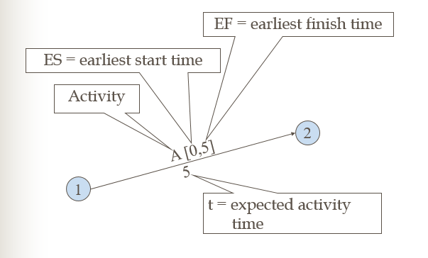
Cont’d

Slide 42
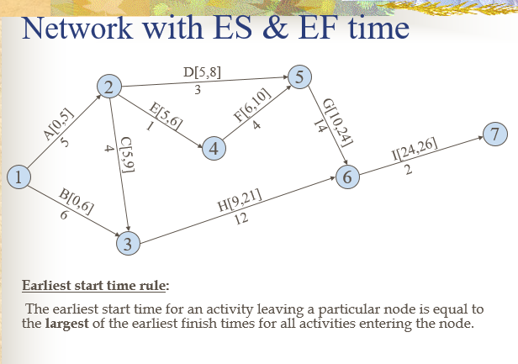
Cont’d

Slide 43
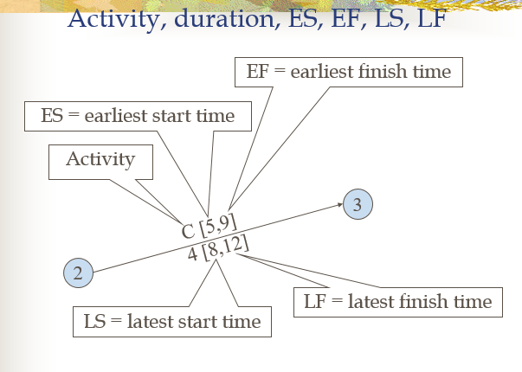
Cont’d

Slide 44
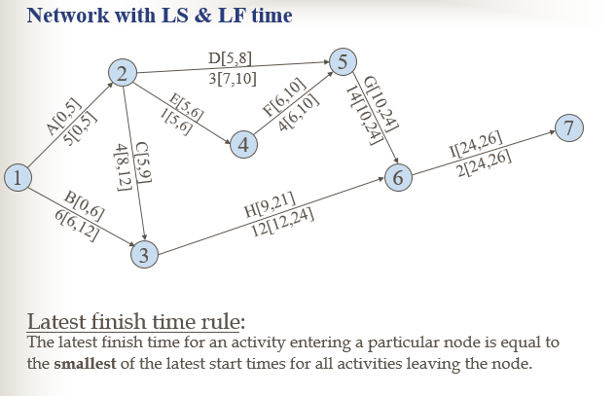
Cont’d

Slide 45
Latest start & latest finish time
To find the critical path we need a backward pass calculation.
Starting at the completion point (node 7) and using a latest
finish time (LF) of 26 for activity I, we trace back through the
network computing a latest start (LS) and latest finish time
for each activity
The expression LS = LF – t can be used to calculate latest start
time for each activity. For example, for activity I, LF = 26 and t
= 2, thus the latest start time for activity I is
LS = 26 – 2 = 24

Slide 46
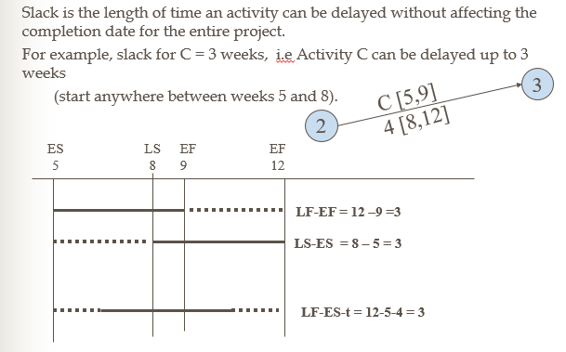
Slack or Free Time or Float

Slide 47
Activity schedule for our example
Activity | Earliest start (ES) | Latest start (LS) | Earliest finish (EF) | Latest finish (LF) | Slack (LS-ES) | Critical path
A | 0 | 0 | 5 | 5 | 0 | Yes
B | 0 | 6 | 6 | 12 | 6
C | 5 | 8 | 9 | 12 | 3
D | 5 | 7 | 8 | 10 | 2
E | 5 | 5 | 6 | 6 | 0 | Yes
F | 6 | 6 | 10 | 10 | 0 | Yes
G | 10 | 10 | 24 | 24 | 0 | Yes
H | 9 | 12 | 21 | 24 | 3
I | 24 | 24 | 26 | 26 | 0 | Yes

Slide 48
IMPORTANT QUESTIONS
What is the total time to complete the project?
  26 weeks if the individual activities are completed on schedule.
What are the scheduled start and completion times for each activity?
  ES, EF, LS, LF are given for each activity.
What activities are critical and must be completed as scheduled in order to keep the project on time?
  Critical path activities: A, E, F, G, and I.
How long can non-critical activities be delayed before they cause a delay in the project’s completion time
  Slack time available for all activities are given.

Slide 49
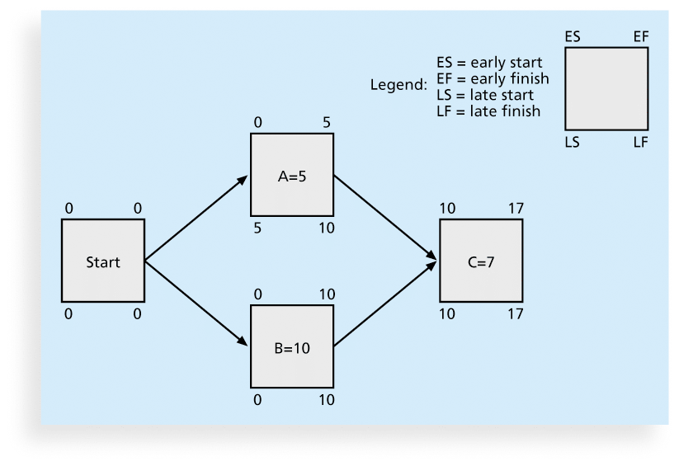
Figure 6-9. Calculating Early and Late Start and Finish Dates

Slide 50
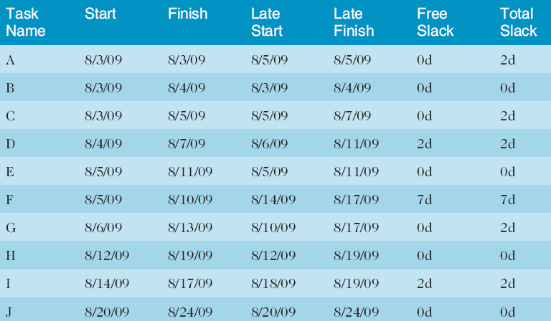
Table 6-1. Free and Total Float or Slack for Project X

Slide 51
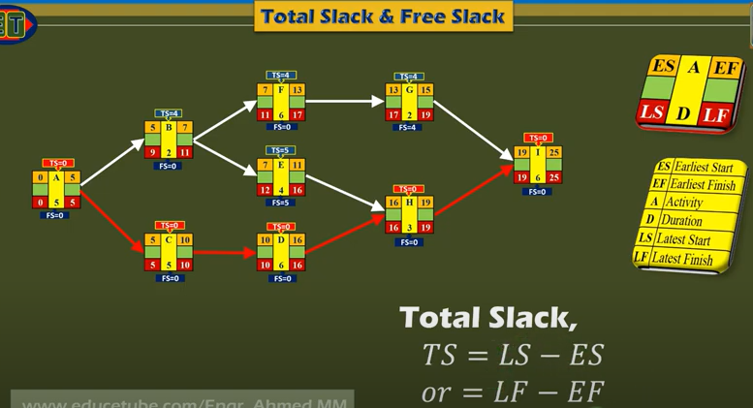
Additional example to calculate free slack and total slack

Slide 52
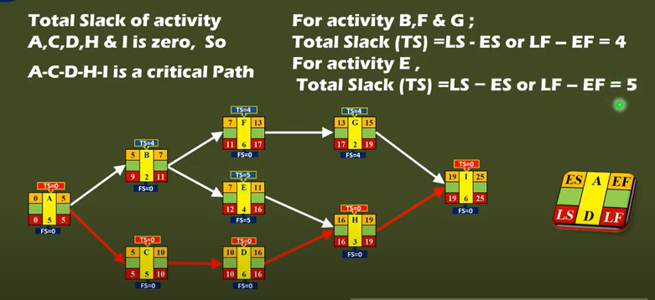
Additional example to calculate free slack and total slack

Slide 53
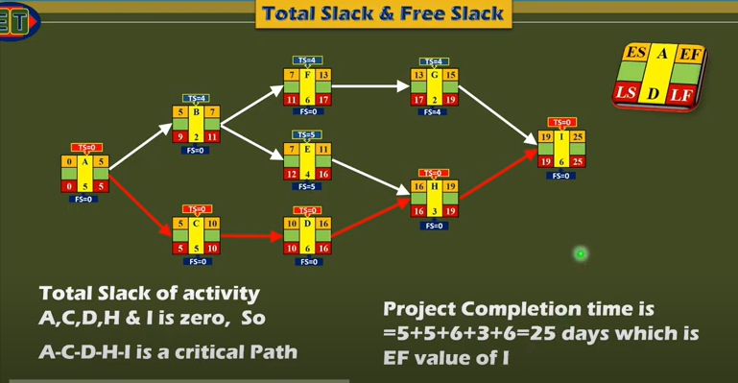
Additional example to calculate free slack and total slack

Slide 54
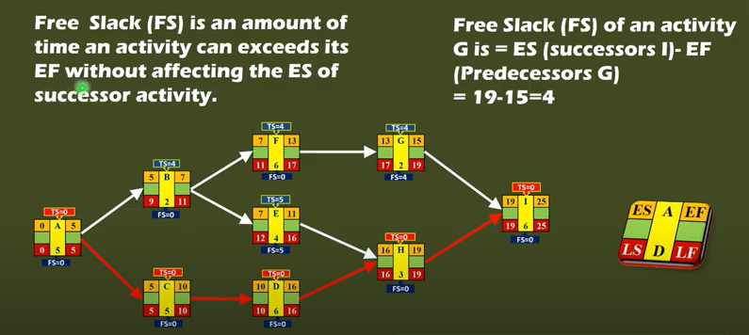
Additional example to calculate free slack and total slack

Slide 55
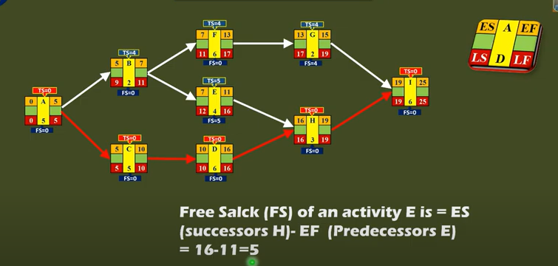
Additional example to calculate free slack and total slack

Slide 56
Importance of Float (Slack) and Critical Path
Slack or Float shows how much allowance each activity has, i.e how long it can be delayed without affecting completion date of project
Critical path is a sequence of activities from start to finish with zero slack. Critical activities are activities on the critical path.
Critical path identifies the minimum time to complete project
If any activity on the critical path is shortened or extended, project time will be shortened or extended accordingly

Slide 57
Importance of Float (Slack) and Critical Path
So, a lot of effort should be put in trying to control activities along this path, so that project can meet due date. If any activity is lengthened, be aware that project will not meet deadline and some action needs to be taken.
6. If can spend resources to speed up some activity, do so only for critical activities.
7. Don’t waste resources on non-critical activity, it will not shorten the project time.
8. If resources can be saved by lengthening some activities, do so for non-critical activities, up to limit of float.
9. Total Float belongs to the path

Slide 58
Using the Critical Path to Shorten a Project Schedule
Three main techniques for shortening schedules
  Shortening durations of critical activities/tasks by adding more resources or changing their scope
  1. Crashing activities by obtaining the greatest amount of schedule compression for the least incremental cost
    Results: shortens time, but increases costs
  2. Fast tracking activities by doing them in parallel or overlapping them
    Disadvantage can end up lengthening the project due to the increased risks and sometimes results in rework

Slide 59
Cont’d
Importance of Updating Critical Path DataImportance of Updating Critical Path Data
It is important to update project schedule information to meet time goals for a project
The critical path may change as you enter actual start and finish dates
If you know the project completion date will slip, negotiate with the project sponsor
  Ask for more time
  Ask for more resources/money to stay on track
  Ask to reduce scope

Slide 60
cont’d
3. Critical chain scheduling
  A method of scheduling that considers limited resources when creating a project schedule and includes buffers to protect the project completion date
Uses the Theory of Constraints (TOC)
  A management philosophy developed by Eliyahu M. Goldratt and introduced in his book The Goal
Attempts to minimize multitasking
  When a resource works on more than one task at a time
  Due to the nature of starting/stopping tasks it may take even longer
  See chart on next page
Uses limited time buffers
Notes:
Critical chain scheduling assumes that resources do not multitask or at least minimize
multitasking. Someone should not be assigned to two tasks simultaneously on the same project when critical chain scheduling is in effect. Likewise, critical chain theory suggests that
projects be prioritized so people working on more than one project at a time know which
tasks take priority. Preventing multitasking avoids resource conflicts and wasted setup time
caused by shifting between multiple tasks over time

Slide 61
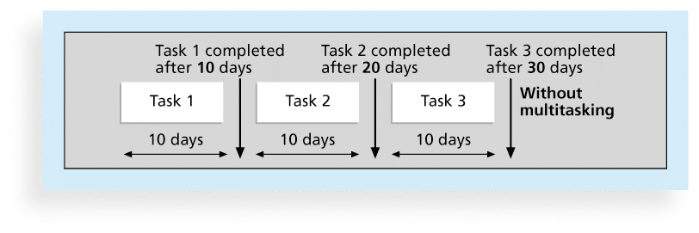
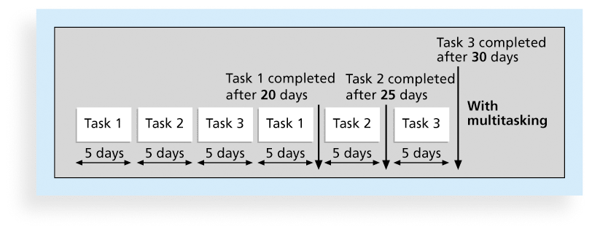
Figures 6-10.a and b. Multitasking Example

Slide 62
Cont’d
    Buffers and Critical Chain
A buffer is additional time to complete a task
Murphy’s Law states that if something can go wrong, it will
Parkinson’s Law states that work expands to fill the time allowed
In traditional estimates, people often add a buffer to each task and use it if it’s needed or not
Critical chain scheduling removes buffers from individual tasks and instead creates
  a project buffer or additional time added before the project’s due date
  feeding buffers or additional time added before tasks on the critical path

Slide 63
Program Evaluation and Review Technique (PERT) For Dealing With Uncertainty
So far, times can be estimated with relative certainty, confidence
For many situations this is not possible, e.g Research, development, new products and projects etc.
Use 3 time estimates
  m= most likely time estimate, mode.
  a = optimistic time estimate,
  b = pessimistic time estimate, and
  Expected Value (TE) = (a + 4m + b) /6

Slide 64
PERT For Dealing With Uncertainty
Advantage: he main advantage of PERT is that it attempts to address the risk associated with duration estimates.
Disadvantage: takes time to do the calculations

Slide 65
PERT Formula and Example
PERT weighted average =
optimistic time + 4X most likely time + pessimistic time
6
Example:
PERT weighted average =
8 workdays + 4 X 10 workdays + 24 workdays = 12 days 6
where optimistic time = 8 days
most likely time = 10 days, and
pessimistic time = 24 days
Instead of using the most likely duration estimate of 10 workdays, the project team would use 12 workdays when doing critical path analysis. for the above example.

Slide 66
Schedule Control Suggestions
Perform reality checks on schedules
Allow for contingencies
Don’t plan for everyone to work at 100% capacity all the time
  There are things a person does in their work day:
    Meetings
    Email
    Talking with the boss
    At Toyota in our plans we used 6 hour days allowing for 2 hours of the other stuff
Hold progress meetings with stakeholders and be clear and honest in communicating schedule issues

Slide 67
Controlling the Schedule
Goals are to know the status of the schedule, influence factors that cause schedule changes, determine that the schedule has changed, and manage changes when they occur
Tools and techniques include
  Progress reports
  A schedule change control system
  Project management software, including schedule comparison charts like the tracking Gantt chart
  Variance analysis, such as analyzing float or slack
  Performance management, such as earned value (chapter 7)

Slide 68
Reality Checks on Scheduling
First review the draft schedule or estimated completion date in the project charter
Prepare a more detailed schedule with the project team (people who do the work)
Get stakeholders’ approval
Make sure the schedule is realistic and followed
Allow for contingencies throughout the life of the project
Alert top management well in advance if there are schedule problems

Slide 69
Reality Checks on Scheduling
Be proactive in managing stakeholder expectations
Verify actual work performed, not just what people report
  How? Ask a person who is dependent on the other person’s work.
Be honest – top management hate surprises
Keep firm dates for key project milestones
Avoid scope creep by managing change control

